Slide 1
Linear Programming using Python and its application in fair room allocation
Under the guidance of Prof. Swaprava Nath
Submitted by Santosh Kavhar

Slide 2



Problem 1
Same rent for every room?
Guest Room
Bedroom
Hall

Slide 3

Problem 2
Same rent for every floor?

Slide 4
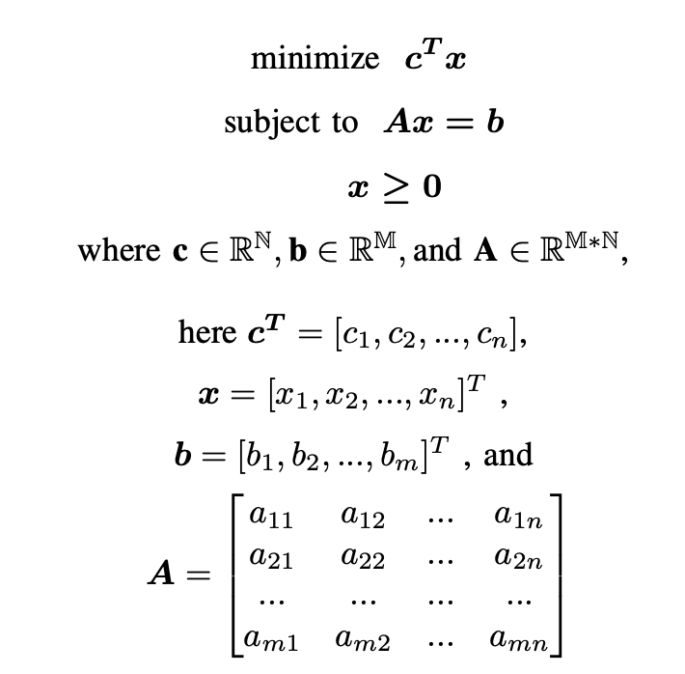
What is LP?
Linear Objective
and Linear inequalities
A method of optimising
operations with some constraints

Slide 5
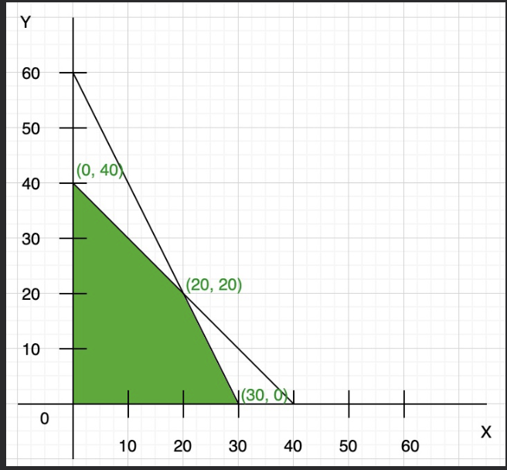
Example
Maximize: Z = 7x + y
Constraints:
x + y <= 40,
2x + y <= 60,
x >= 0, y >= 0
Max at (30, 0) -> Optimal value 210

Slide 6

What is Python?
Interpreted
Interesting
User friendly language

Slide 7
Motivation
Why this problem?
Real world
Why LP?
Used in the implementation paper
Easy and efficient
Why Python?
Strong community
Support of PuLP

Slide 8
The Solution
Maximize the minimum utility each player is receiving
First step is to find Maximum Welfare Assignment
Second step is to ensure Envy-freeness

Slide 9
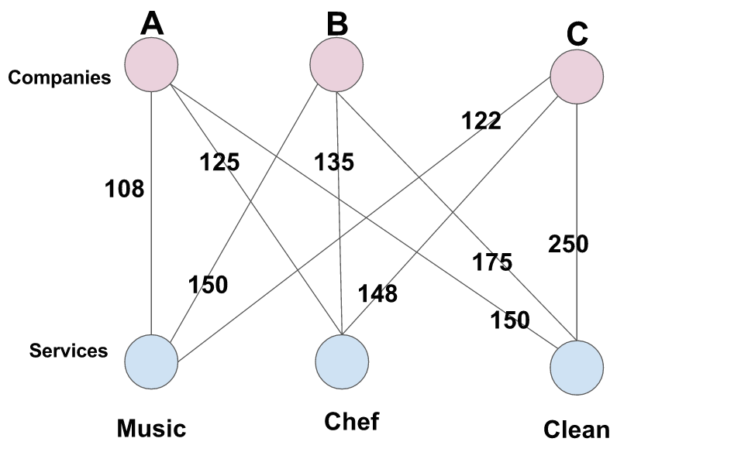
Maximum Welfare assignment
-aka Maximum Weight Bipartite Matching

Slide 10
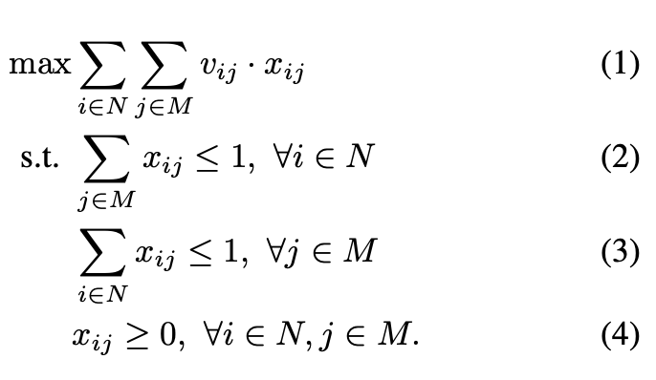
It’s Formulation
Renter i’s value for room j
x_{ij} is 1 when renter i will be assigned room j
Maximization Problem
A renter can be allotted at max one room
A room can be allotted to at max one renter
Non-
negativity constraint

Slide 11
Example
Maximum welfare assignment or MWBM
Rent per Room\ Renter | Alice | Bob | Cathy
Main Hall | 300 | 400 | 250
Bedroom | 300 | 200 | 250
Guest Room | 400 | 400 | 500

Slide 12

Envy-freeness
The profit or utility is fair for
all the players., i.e No renter
envies another renter.

Slide 13
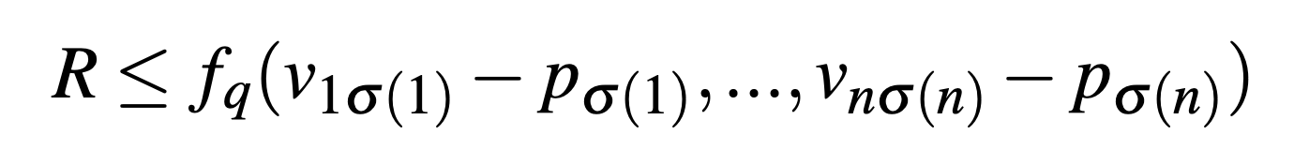
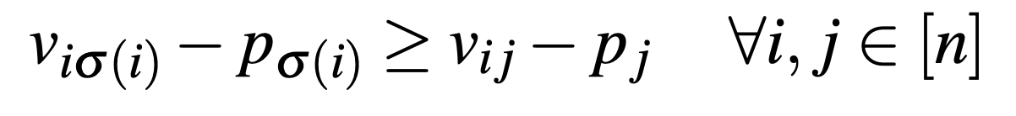
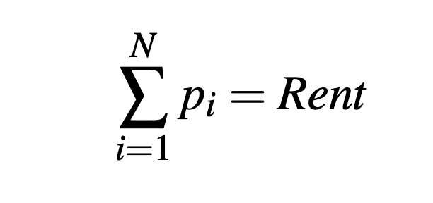
Envy-freeness formulation
Room allocated to renter 1
Room allocated to renter n
Minimization Problem:
Final price of Room j
Renter i’s value for his allocated room

Slide 14
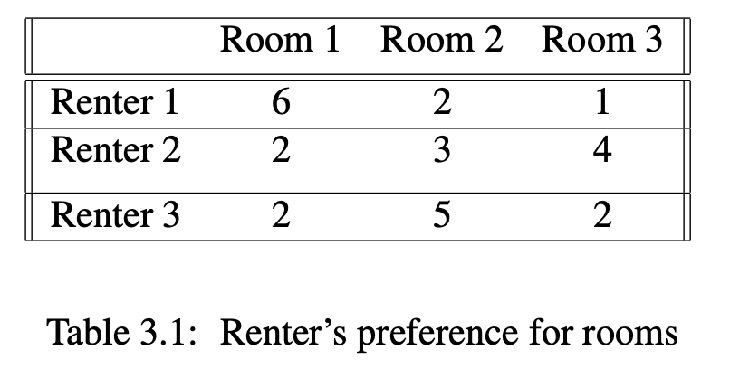
The Problem:

Slide 15
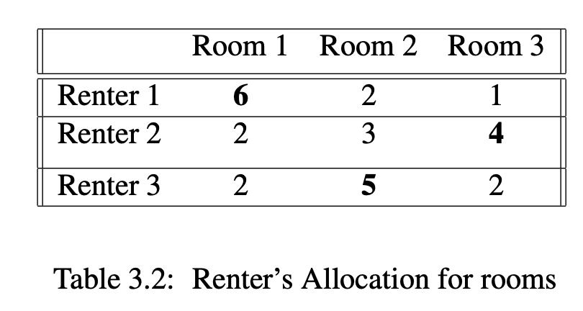
MWBM: Allocation is derived

Slide 16
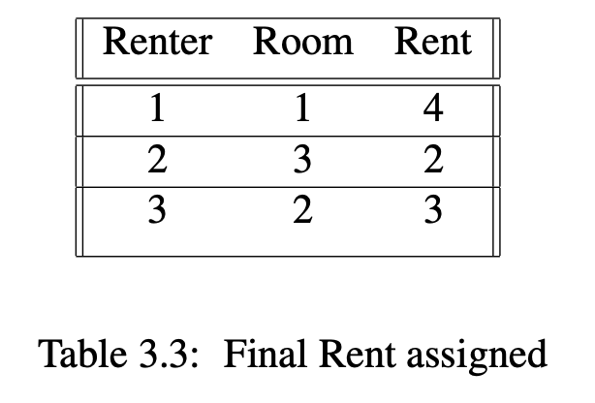
Final Maximin Solution

Slide 17
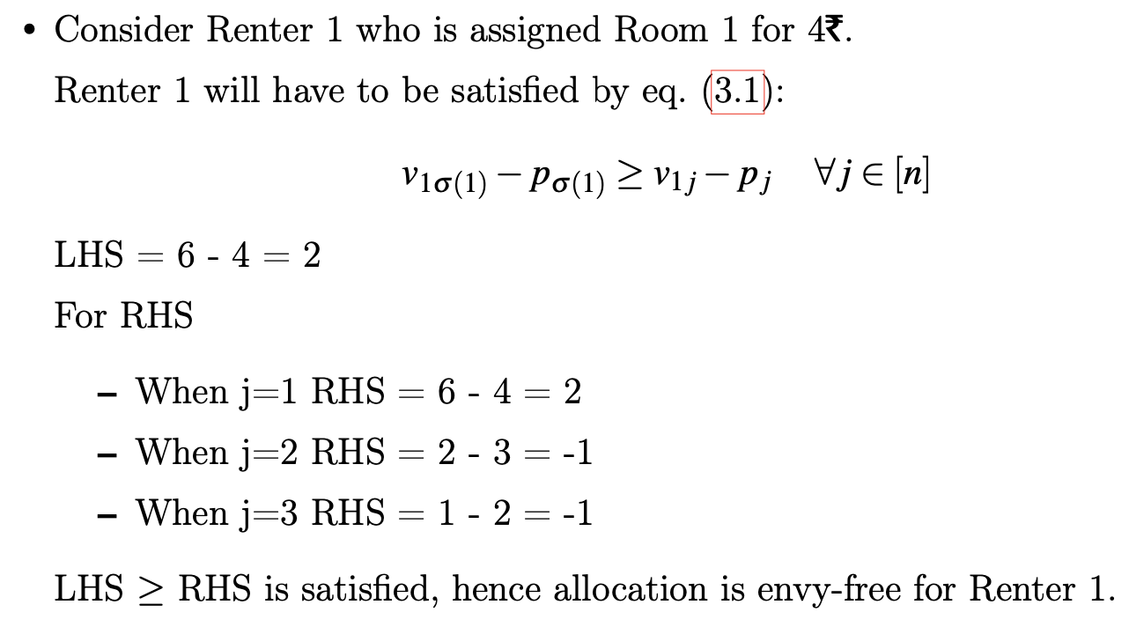
Analysis for Renter 1

Slide 18
PuLP
Variable -> x1 = LpVariable("x1", 0, None, LpInteger)
Problem -> problem = LpProblem("Room_Allocation", LpMaximize)
Optimization -> problem += 6* x1 + 4 * x2 + 7 * x3 + 5 * x4
Solve -> problem.solve() method

Slide 19
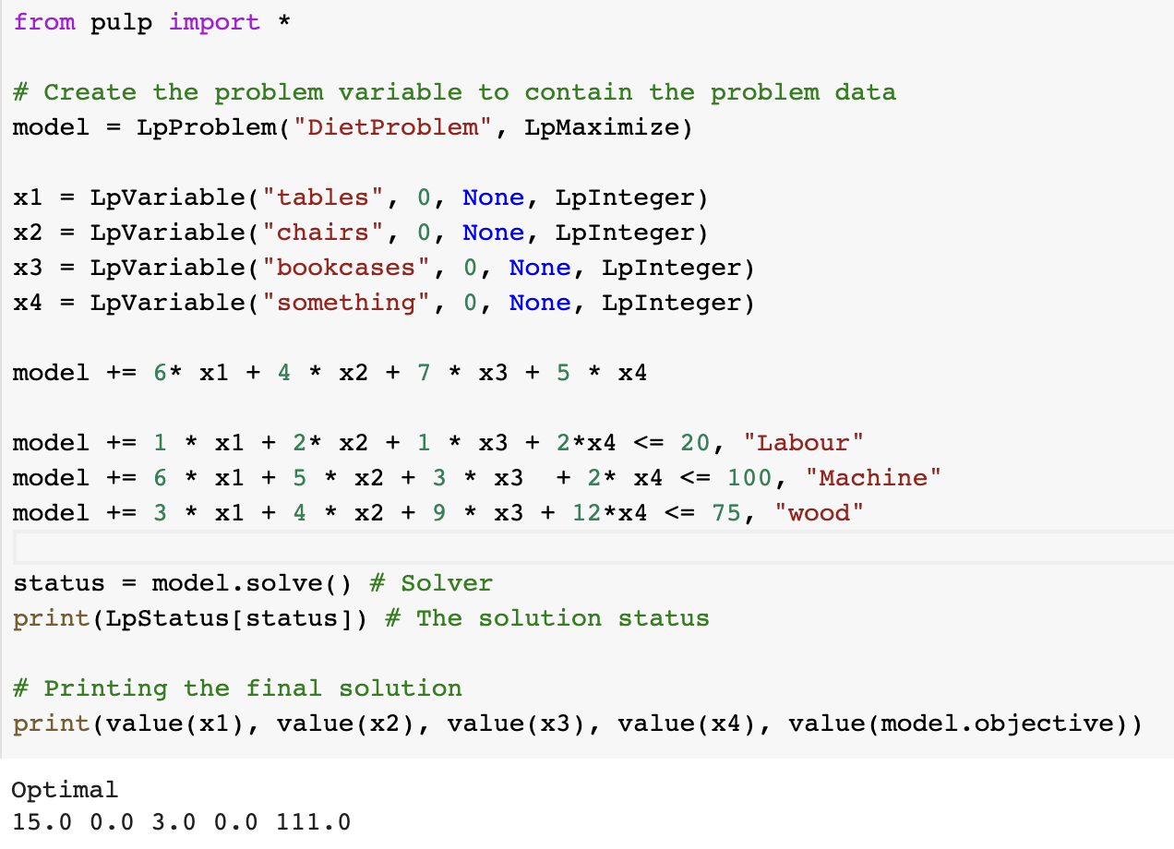
PuLP Implementation
Furniture

Slide 20
Hostel Allocation
Renter i’s value for floor j
x_{ij} is 1 when renter i will be assigned floor j
Maximization Problem
A renter can be allotted at max one floor
A floor can be allotted to at max Cj renters
C
Cj
Capacity of floor j
Non-
negativity constraint

Slide 21
Example of Hostel Allocation
TODO:
Add the problem values
Normalize the values
Add the solution values
Do analysis on Maximum Welfare
Do analysis on Envy-freeness

Slide 22
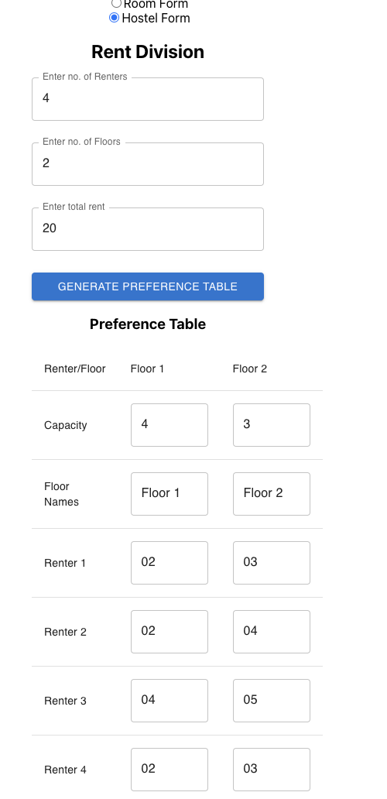
Problem

Slide 23
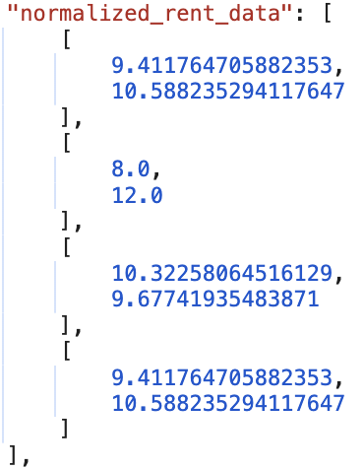

Slide 24
Calculation of Normalised value
Eg.
Consider 2nd Renter:
2*4 * x + 4*3 * x = 20
Therefore x = 1
Normalized Value for Floor 1: 2*4 * 1 = 8
Normalized Value for Floor 2: 4*3* 1 = 12

Slide 25
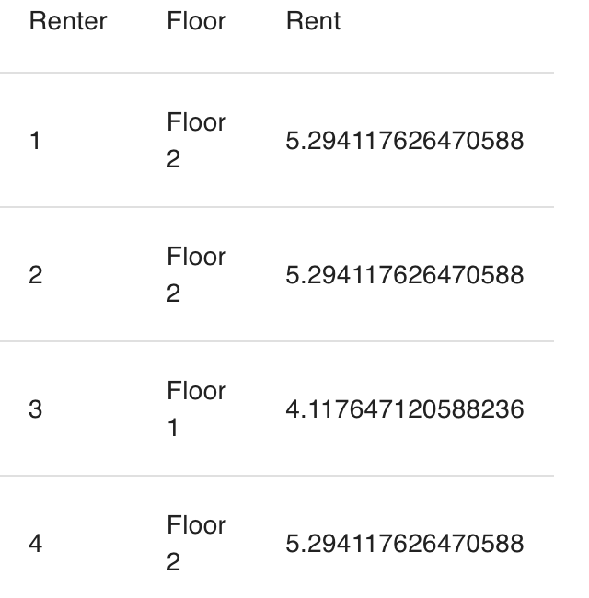
Solution

Slide 26
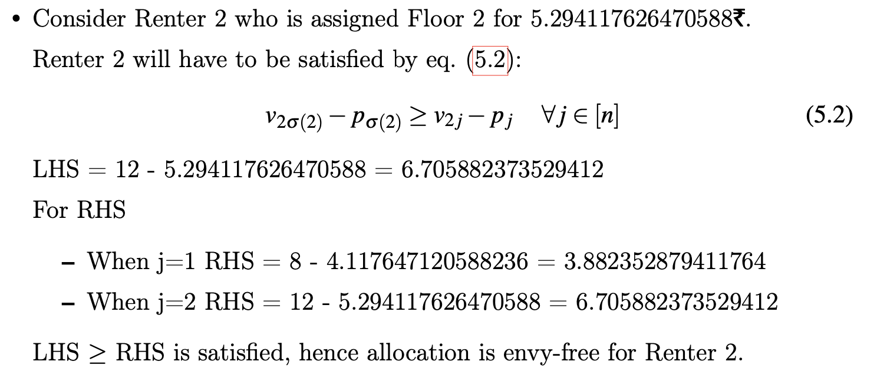
Analysis

Slide 27
Conclusions
LP to do the fair house allocation and Hostel allocation with help of PuLP library in python.
First step is to do maximum welfare assignment
Second is to ensure envy-freeness

Slide 28
Future Scope
Improve as per suggestions from guide
Implement spliddit like application for other goods as well

Slide 29
THANK YOU!!

Slide 30
References
Edwin KP Chong and Stanislaw H Zak. An introduction to optimization, volume 75. John Wiley & Sons, 2013.
Ya’akov (Kobi) Gal, Moshe Mash, Ariel D. Procaccia, and Yair Zick. Which is the fairest (rent division) of them all? In Proceedings of the 2016 ACM Conference on Economics and Computation, EC ’16, page 67–84, New York, NY, USA, 2016. Association for Computing Machinery. ISBN 9781450339360. doi: 10.1145/2940716.2940724. URL https://doi.org/10.1145/2940716.2940724.
Stuart Mitchell, Michael O Sullivan, and Iain Dunning. Pulp:a linear programming toolkit for python. The University of Auckland, Auckland, New Zealand, 65, 2011.

Slide 31
TODO:
Analysis of Envy-freeness by considering capacity

